Slide 1

Real Estate Investment by Percentages using Python
Ayush Bhandari (23106117)
Jayraj Dhole (23106114)
Project Guide
Prof. Yogeshwari Hardas
Anushka Khandar (23106041)
Shaunak Das (23106002)

Slide 2
Introduction
The real estate market has long been a prime area for investment, but accessibility remains a challenge due to the high costs associated with purchasing entire properties.
Motivation: This project aims to develop a website where individuals can invest in real estate by purchasing a fractional ownership of properties, such as plots, flats, or commercial spaces, with as little as 2%, 5%, or any desired percentage.
Objectives: This innovative platform provides a flexible and inclusive approach to real estate investments, enabling greater participation from diverse investors.

Slide 3
Problem statement
Traditional real estate investment requires significant capital, which limits opportunities for small-scale investors. Liquidity is less in the traditional real estate investment.
Additionally, the lack of an efficient online platform for fractional property ownership creates barriers for individuals seeking to diversify their portfolios with minimal risk.

Slide 4
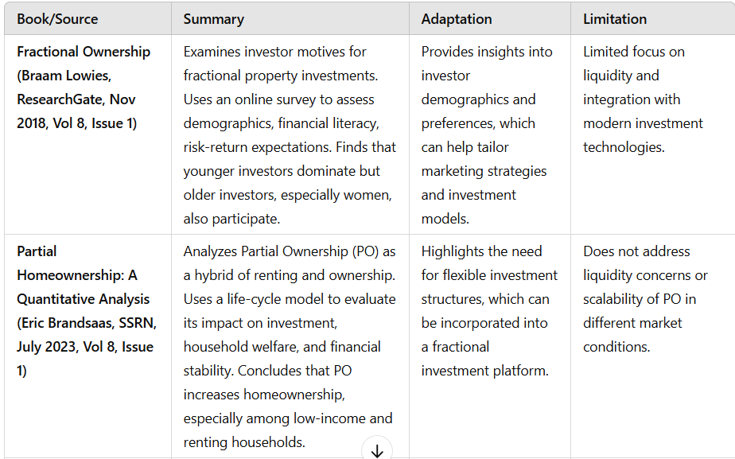
Literature Survey of the Existing System

Slide 5
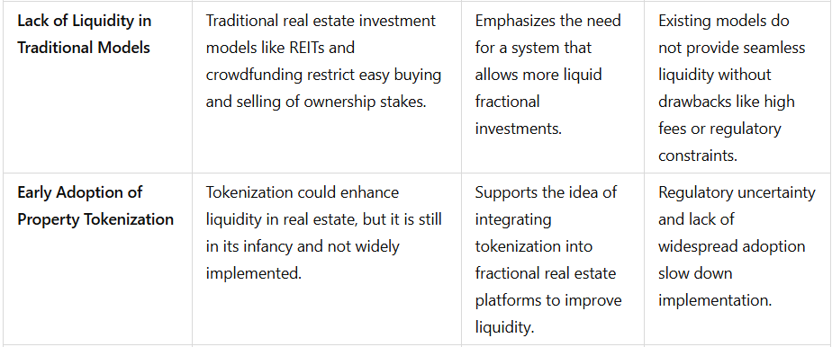
Literature Survey of the Existing System

Slide 6
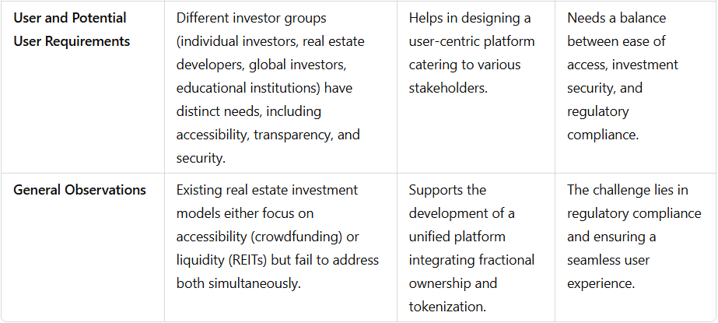
Literature Survey of the Existing System

Slide 7
Technologies and Methodologies
The proposed system includes user registration, property listing details with investment options and real-time investment tracking.
Users will be able to view properties, calculate potential returns on investments, and purchase fractional ownership with ease.
The backend handles dynamic pricing, user accounts, and transaction records, ensuring transparency and security.
Implementation will prioritize scalability to accommodate future expansions, such as integrating blockchain for secure ownership records.

Slide 8
Existing Systems
(Advantages and Limitations)
Real estate investment trusts (REITs) are companies that own, operate, or finance income-producing real estate across a wide range of property sectors. These investments allow you to earn income from real estate without having to buy, manage, or finance properties themselves.
REITs generate a steady income stream for investors but offer little capital appreciation.
RealT, Lofty AI, SolidBlock, tZERO, and Labs Group—Lofty AI allows investors from India to participate in fractional real estate investments.

Slide 9
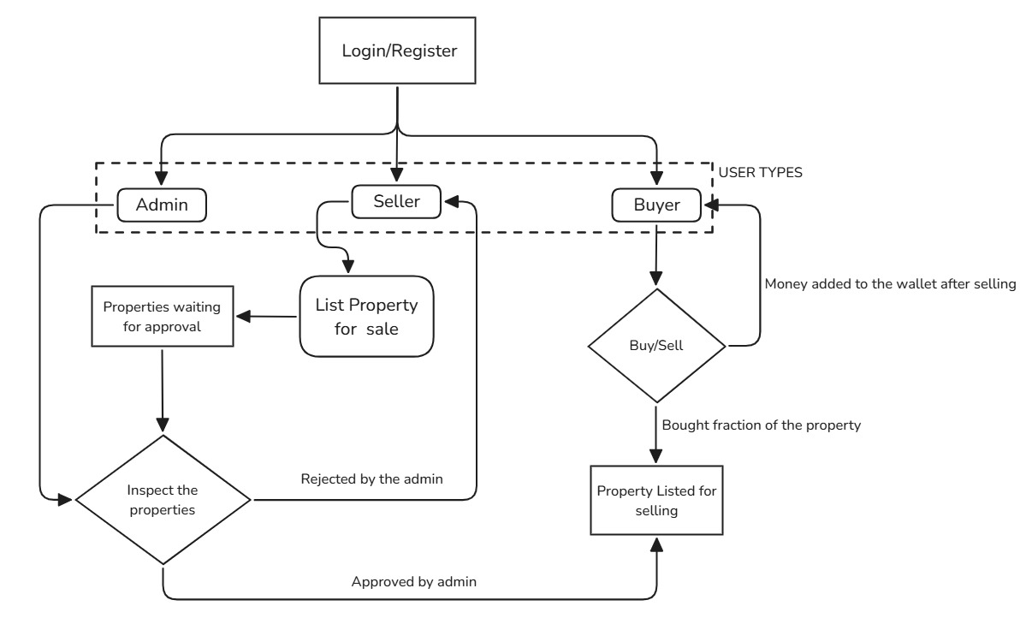
System Design

Slide 10
System Design
Web Framework: Django, used for developing the backend of the platform, enabling seamless communication between the server and user interface for transactions, property data management, and user interactions.
Data Storage: MySQL, employed to store user data and property information, ensuring data integrity and availability.
Payment Integration: Stripe is integrated for secure, real-time payment processing.
User Interface Framework: Html, JavaScript, CSS used for creating a dynamic, user-friendly frontend interface that allows users to interact with the platform and view real-time updates on their investments.

Slide 11
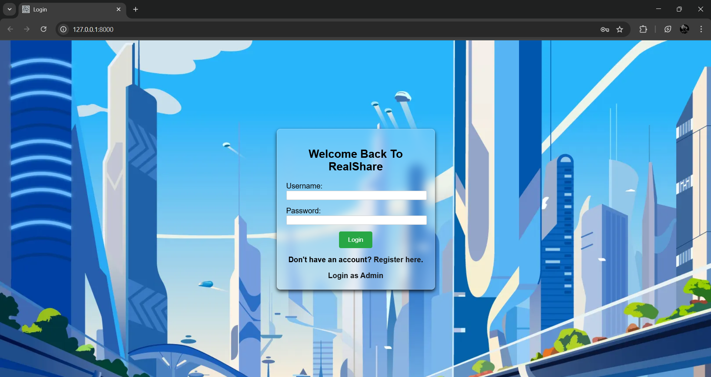
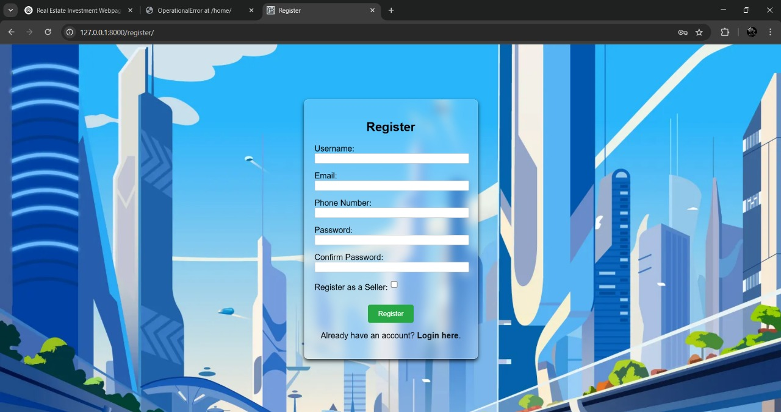
Implementation
Login Page :
(if account exists)
Registration Page :
(if account does not exist)

Slide 12
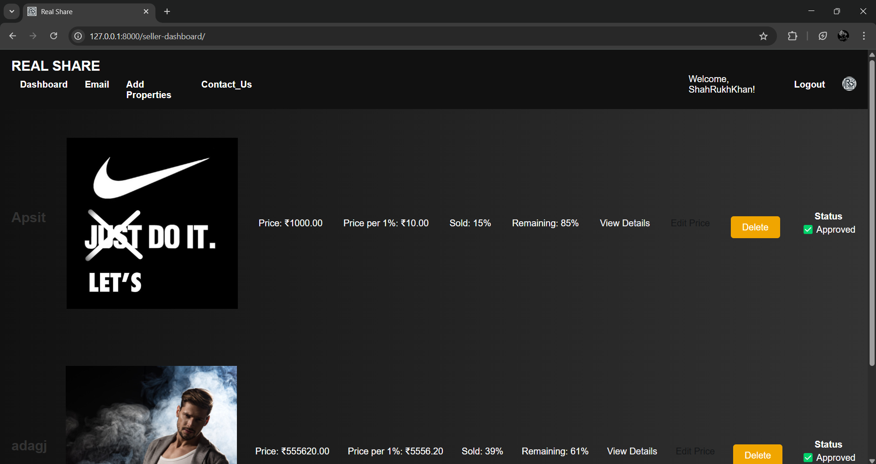
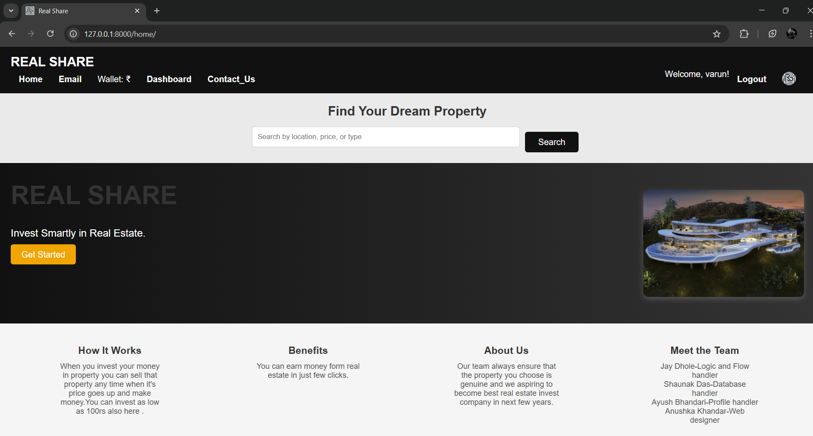
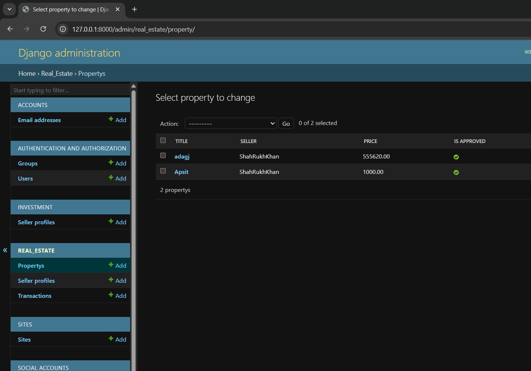
Implementation
Seller Dashboard
Buyer Dashboard
Admin Dashboard

Slide 13
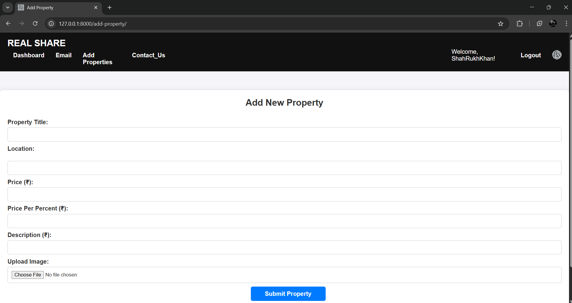
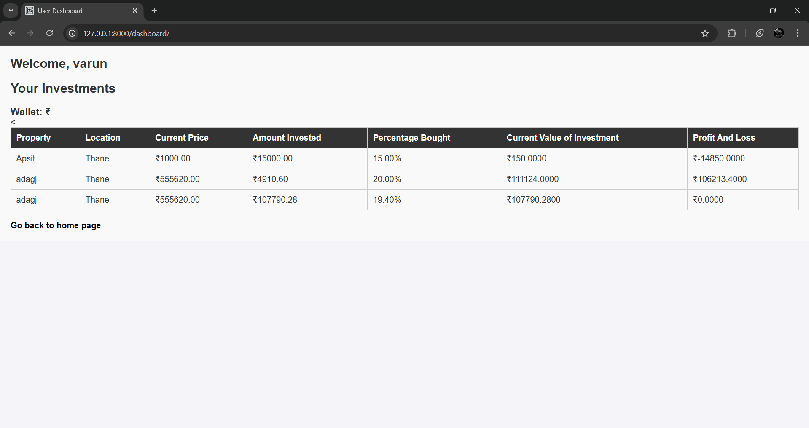
Implementation
Add Property Page for Seller
Buyer Portfolio

Slide 14
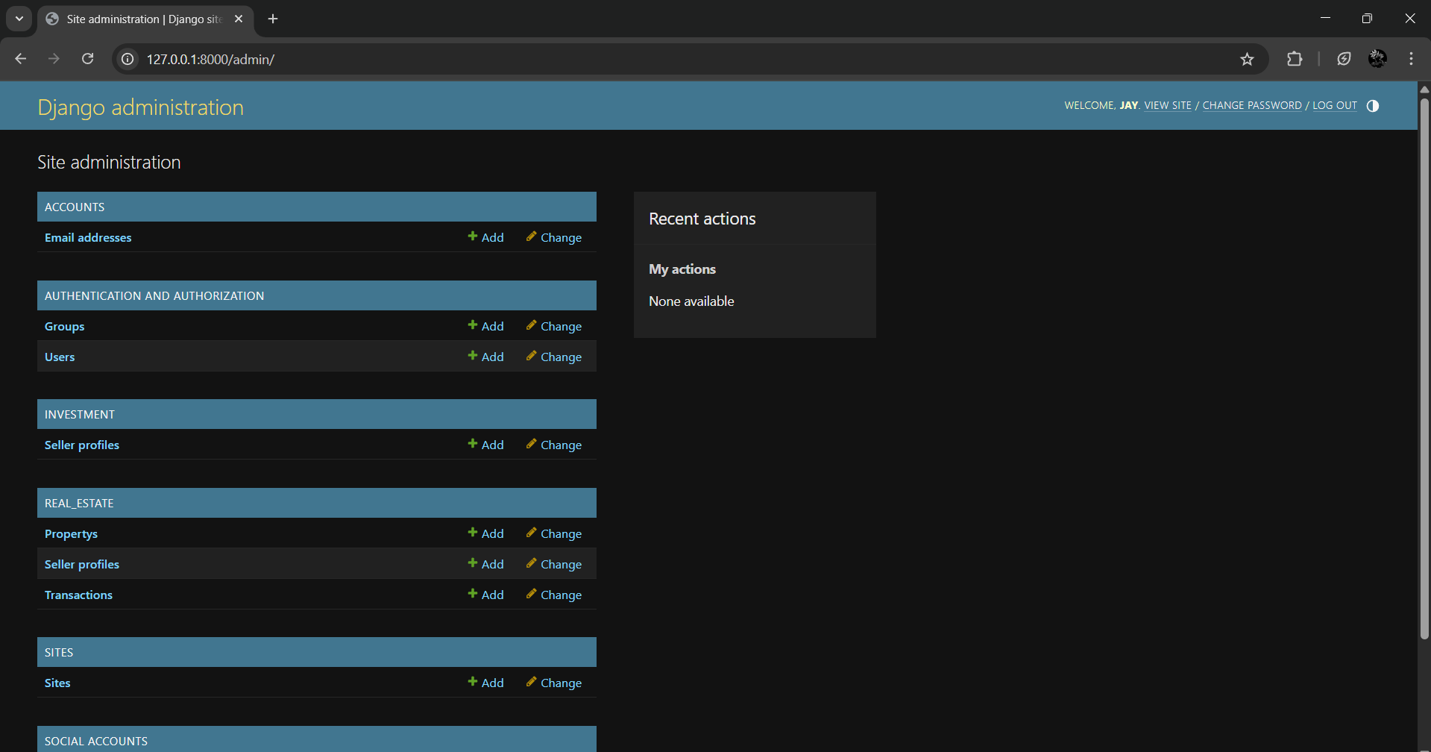
Implementation
Admin Panel

Slide 15
Conclusion
This project addresses the accessibility issues in real estate investments by offering a fractional ownership model through a user-friendly website.
By making property investment more inclusive and convenient, this platform has the potential to revolutionize the real estate market, encouraging broader participation and fostering economic growth.

Slide 16
Thank You...!!

Slide 17
Existing studies and platforms in fractional real estate investment highlight the growing interest in democratizing property ownership.
Current solutions fail to cater to small-scale investors effectively. More recently, REITs (Real Estate Investment Trusts) emerged, enabling investors to pool funds and invest in large-scale real estate projects, but without direct property ownership. AssetPlus, Zillow, SmartAsset.
With advancements in financial technology (FinTech) and blockchain technology, the idea of partial investment in real estate has evolved significantly.

Slide 18
References
All papers should be from Scopus/ SCI indexed journal / Conferences such as IEEE, Springer, ACM,etc.
All references should be arranged based on the year of publications. With latest year on top.
All references should be in the following form.
All Author names, Title of the Project, Publisher full details, volume, page number details, year of publication. Highlight the title and the Year.
Also give the link to each paper so that you can show the paper / site.

Slide 19
Outline
Introduction
Literature Survey of the Existing Systems
Limitations of the Existing Systems
Problem Statement
System Design
Technologies and Methodologies
Implementation Screenshots(Partial )
Conclusion
References

